Slide 1
“STAKEHOLDERS” OR MORE?
Joe Watkins, Choctaw Nation of Oklahoma

Slide 2
List of Topics Covered
Tribal Sovereignty
History of Federal-Tribal Relationships
The Marshall Trilogy
Johnson v. M’Intosh (1823)
Cherokee Nation v. Georgia (1831)
Worcester v. Georgia (1832)
Contemporary Tribes as Nations
Recognition (Federal, State, None) and its Consequences
The Trust Responsibility

Slide 3
Learning Goals
Recognize the specific legal and political relationship between the federal government and federally recognized tribes
Compare and contrast federal vs. non-federal recognition and its impact (benefits and consequences)
Analyze the trust responsibility of the federal government to tribes

Slide 4
“stakeholders”
Individuals or groups of individuals
Neighborhood associations
Organizations (both “For-profit” and “Not-for-profit”)
State governments
Federal agencies
Tribes

Slide 5
Sovereignty
Definitions (Merriam-Webster Dictionary):
“supreme power especially over a body politic”
“freedom from external control”
“an autonomous state”
“a country’s independent authority and the right to govern itself”
Is Sovereignty given, earned, or something else?
Does Sovereignty require the recognition or “approval” of others?

Slide 6
A brief history
1621 – First treaty between Plymouth colonists and Wampanoag Indians
1778 – First treaty between United States and Indians “Treaty with the Delawares (sic)”
Last United States treaty “Treaty with the Nez Percés (sic), 1868,” but “Agreement with the Columbia and Colville, 1883” ratified in 1884.
Between 1778 and 1871, more than 370 treaties or agreements ratified by Congress
1871– Congress ceased recognition of individual tribes within the US as independent nations with who the US could contract by treaty

Slide 7
Why treaties?
Continuation of English practices of dealing with tribes as foreign nations
During colonization, the British and many of the colonies treated Indian tribes as sovereign nations holding title to their lands and entered into treaties with the tribes recognizing their title.
Tribes had military power prior to and in early years of United States
Other global governments recognized American Indians as separate governments and sometimes entered into treaties to buffer or battle against American/colonial settlements
Treaties provided:
Recognition of title
Acknowledgment of the protection of the US
Specific rights secured – beneficial ownership of land, hunting and fishing rights, water rights, federal services like health and education services

Slide 8
The constitution and tribes
Article I, Section 2, Clause 3 of the Constitution: "Representatives and direct Taxes shall be apportioned among the several States ... excluding Indians not taxed."
Article I, Section 8 of the Constitution: “Congress shall have the power to regulate Commerce with foreign nations and among the several states, and with the Indian tribes”, determining that Indian tribes were separate from the federal government, the states, and foreign nations; and
The Fourteenth Amendment, Section 2 amends the apportionment of representatives in Article I, Section 2 above.

Slide 9
Three principles of Indian law
Territorial Sovereignty
Tribal authority on Indian land is organic and is not granted by the states in which Indian lands are located.
Plenary Power Doctrine
Congress, and not the Executive Branch, has ultimate authority with regard to matters affecting the Indian tribes. Federal courts give greater deference to Congress on Indian matters than on other subjects.
Trust Relationship
The federal government has a "duty to protect" the tribes, using legislative and executive authorities to effect that duty.

Slide 10
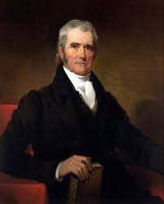
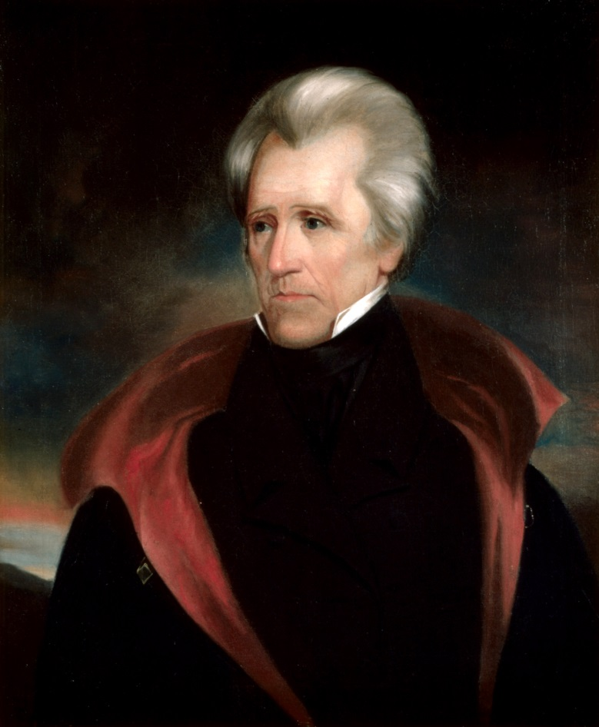
John marshall (left) and andrew jackson

Slide 11
The marshall trilogy
U.S. Supreme Court Justice John Marshall wrote the majority opinion in three Supreme Court cases regarding Indian tribes:
Johnson v. M'Intosh (1823) held that private citizens could not purchase lands from Native Americans
Cherokee Nation v. Georgia (1831) held that the Cherokee nation was a “domestic, dependent nation,” with a relationship to the United States like that of a "ward to its guardian”
Worcester v. Georgia (1832) laid out the relationship between tribes and the state and federal governments, stating that the federal government was the sole authority to deal with Indian nations
President Andrew Jackson is reported as having responded: “John Marshall has made his decision, now let him enforce it.”

Slide 12
Contemporary Tribes as Nations
574 Federally Recognized Tribes as of January 7, 2022, with elected governing bodies
Federal government has sole authority to deal with Indian nations
“Compacts” between Tribes and States allow more formal interaction between Tribal and State governments on specific topics of concern

Slide 13
What does “recognition” mean?
Federal recognition means that Congress “recognizes” that it has a trust responsibility to a Tribal nation like a “guardian to its ward”
Primarily fiduciary but also political
State recognized Tribes do not have the same legal status as Federally recognized Tribes
Groups having neither Federal nor state recognition do not have equivalent status

Slide 14
Nature and scope of trust responsibility
The federal government must support and encourage tribal self-government and economic prosperity, and protect tribes and their interests.
The federal government has an obligation to ensure tribal resources are managed in a manner that promotes Indian interests.
A fiduciary relationship exists between the Federal Government and Indian tribe that:
Requires the highest degree of responsibility
Requires utmost loyalty
Requires Federal Government and its agencies to advocate for tribes, act in good faith toward tribes and seek to make tribal resources productive and profitable.

Slide 15
Why does this matter?
Relationships with Tribes are based on a government-to-government basis
Tribes have a legally defined status different than that of other groups
Tribes are not ethnic groups but separate nations
Federal government is required to seek out Tribal comments and concerns in regard to laws relating to heritage/cultural resources and repatriation

Slide 16
References & Acknowledgments
D’Errico, Peter. 1997. “American Indian Sovereignty: ‘Now You See It, Now You Don’t.’” Online document at http://people.umass.edu/derrico/nowyouseeit.html, accessed 7/1/2017.
National Archives. American Indian Treaties. https://www.archives.gov/research/native-americans/treaties
Portrait of John Marshall by Henry Inman, 1932. Original in Library of Virginia. Wikimedia Commons, Public Domain.
Portrait of Andrew Jackson by Ralph E. W. Earl, 1835, White House Presidential Portrait Collection. https://www.whitehousehistory.org/galleries/presidential-portraits public domain.
National Science Foundation grants 1449465, 1540447

