Slide 1
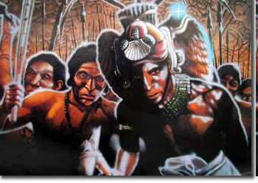
Please Note: Some of the
slides in this presentation
display human remains
Misunderstanding the Past:
What Everyone Should Know About the Maya Collapse
Dr. Anne Pyburn
Provost’s Professor of Anthropology
Notes:
1 Title slide

Slide 2
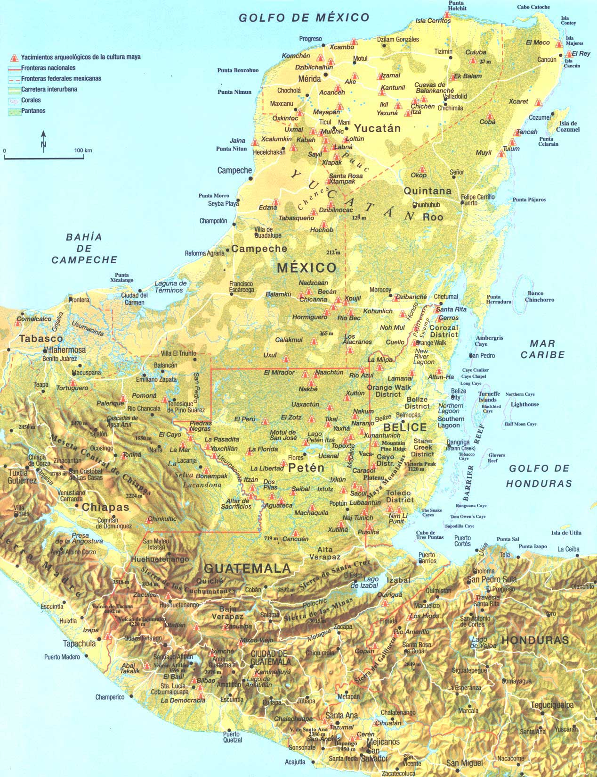
We don’t really
know as much
about the ancient
Maya as
National Geographic
and the
Discovery Channel
would have you think
Notes:
Today I want to make three points about the Maya collapse:
First of all, we don’t really know as much about the Maya classic period as you might think from the media coverage of what archaeologists say to newspaper reporters
Second it is important to be really clear about which Maya we are talking about
And third, that science is not independent of the culture of the scientist who practices it. Even if you know this, sometimes our understanding of the world is more biased than we realize

Slide 3
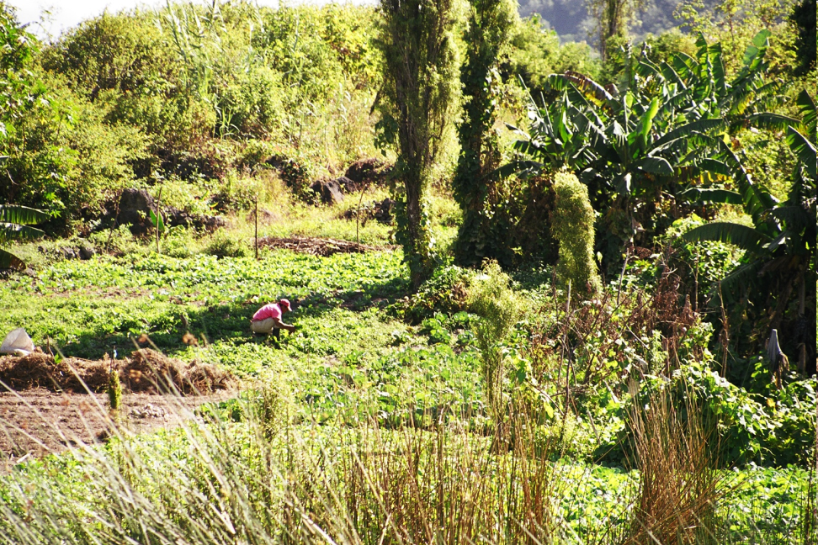
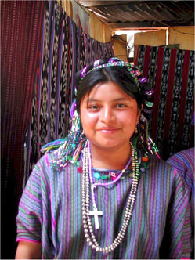
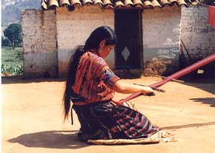
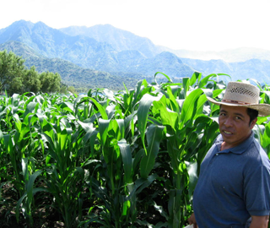
8-10 million people speak Maya languages today
Notes:
Point 1: As a result of the constant stream of media releases and television specials focused on the Maya Collapse, a surprising number of people do not realize that Maya people are very much alive today.
So you should know that there are over 8 million Maya speakers who live in cities and towns and rural areas just as they always have. Maya farmers continue to farm the jungle lowlands of Belize and Mexico and Honduras and Guatemala and the dry karst of Yucatan and the cool highlands of Chiapas.
This is not to say that things haven‘t changed, but to give credit where it is rarely given but where it is certainly due for a degree of sustainability that is truly phenomenal

Slide 4
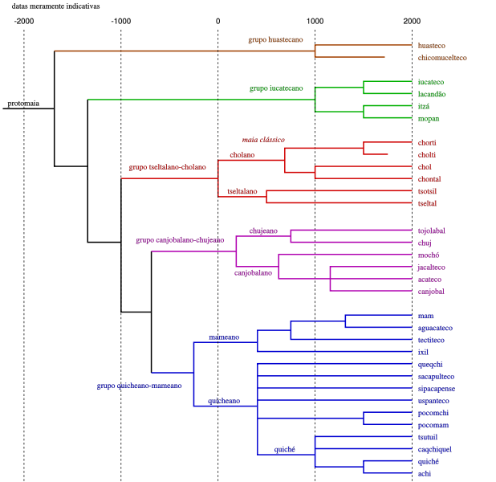
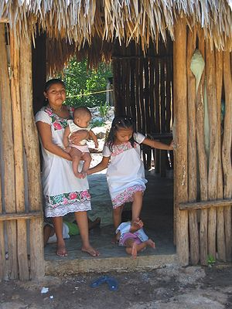
There are many
Maya languages
and cultures
Notes:
Point number two, as for who we are talking about, the word “Maya” is a generic category referring to a large group of people who speak more or less related languages - there are many Maya languages and cultures now and there were many in the past
This means that talking about a Maya collapse is sort of like talking about the fall of Rome or Constantinople as the collapse of Europe

Slide 5
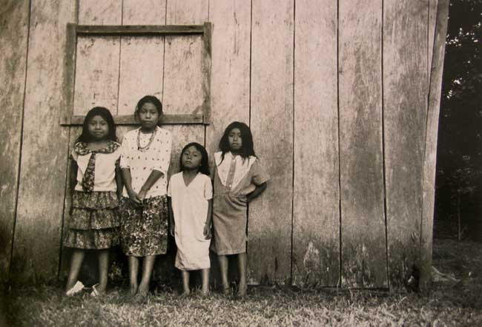
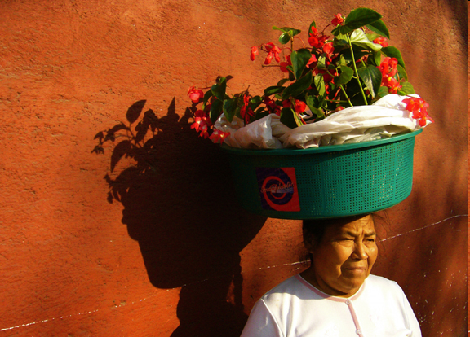
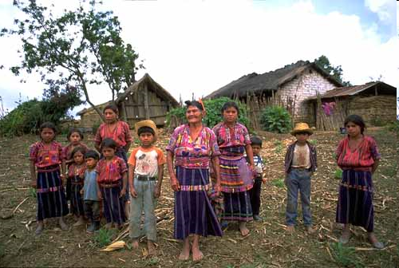
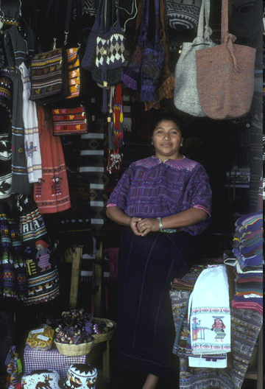
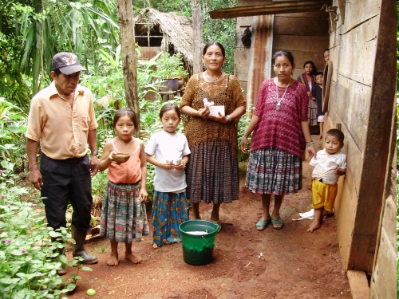
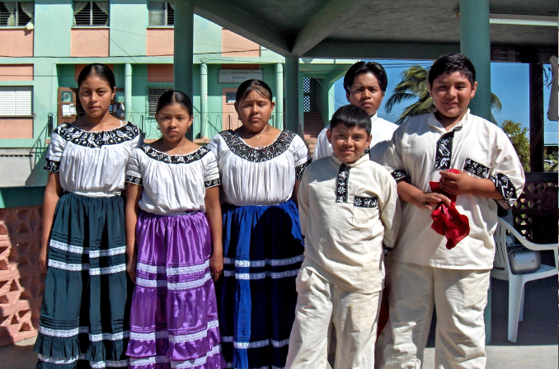
“Maya” is a colonial word
Quiche
Lacondon
Mam
Cakchiquel
Kekchi
Mopan
Notes:
Furthermore the term Maya is a colonial word for people who did not even consider themselves related much less the same; 30 years ago the Kekchi Maya of southern Belize did not know they were Maya

Slide 6
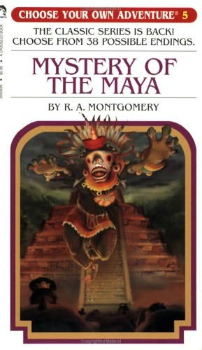
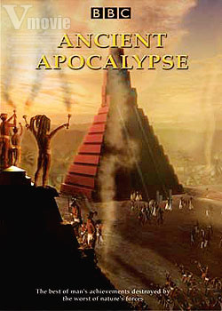
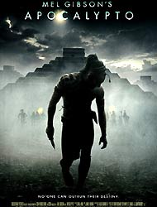
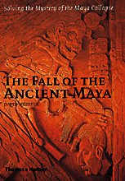
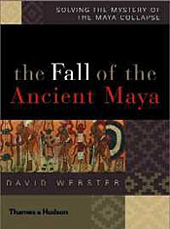
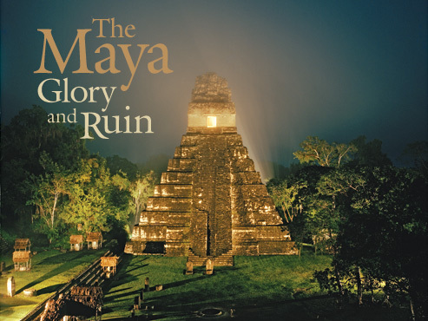
Harmless Entertainment
Esoteric Academic Research
Notes:
My third point is that - Our fascination with the Maya collapse has as much to do with modern environmental problems as it has to do with the ancient Maya – maybe more; and mangling the history & heritage of people who are economically disadvantaged and politically oppressed in the present day in order to teach “lessons” to the wealthy and powerful has some unfortunate political repercussions. Though it may seem superficially politically correct, this approach may not be teaching the correct lessons at all

Slide 7
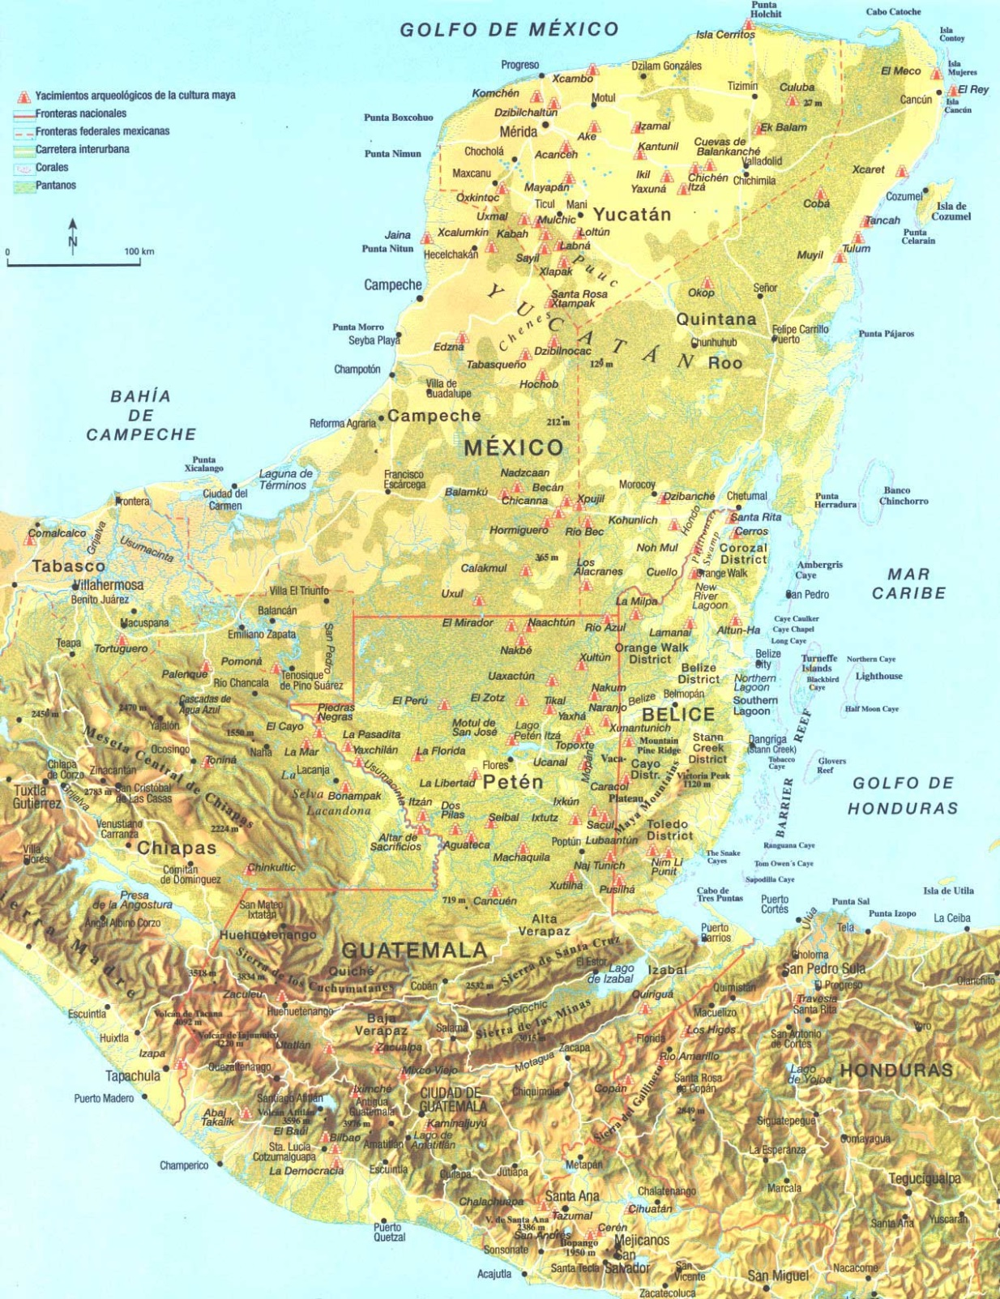
Cuello
Belize
ca 1100
Notes:
MAP OF Maya territory – POINT OUT CUELLO
So who were the Maya and what do we mean when we say their civilization collapsed?
The Maya first made the artifacts that are recognizable to us at about 1100 BC, when they began to make a style of pottery that was distinct and was the first to appear in the area of Central America called the Maya Lowlands.

Slide 8
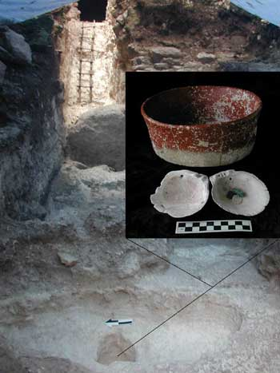
Cival, Petén, Guatemala
Notes:
SLIDE: Swasey pots
Now if you’ve had an anthropology class or have become a devotee of archaeology magazine, you may be surprised to learn that this early pottery wasn’t cookware. It was produced by specialists, and it was double slipped and very delicate -- beautiful stuff, really, and it was probably almost exclusively for display. It is no accident that the earliest Maya are known to us by their pottery, since the purpose of the pottery was probably to identify them to themselves and to other people as – a distinct ethnic group. We don’t know what they called themselves, if anything. But they were the ancestors of the peoples we call Maya today.

Slide 9
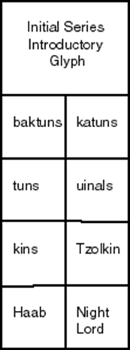
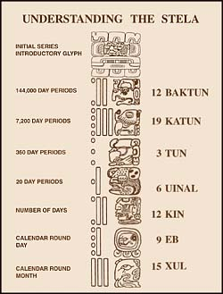
Notes:
CALENDAR I don’t have time to give you many details of ancient Maya accomplishments; briefly a few include: a CALENDAR MORE ACCURATE THAN the European calendar of the time
You may have heard that the Maya considered time to be cyclical – well so do we, our calendar repeats week days and months and we keep track of events to try to use knowledge of the past to predict the future, our greatest historians have claimed that history repeats itself, and our politicians have also depended on astrology [Ronald Reagan consulted an astrologer]
And in addition to the short count which repeated dates at shorter intervals, the classic Maya also used the long count that gave them absolute dates, just like the Gregorian calendar, only using a more complex, format with more accurate results– actually they used several calendars – oops that’s another lecture!

Slide 10
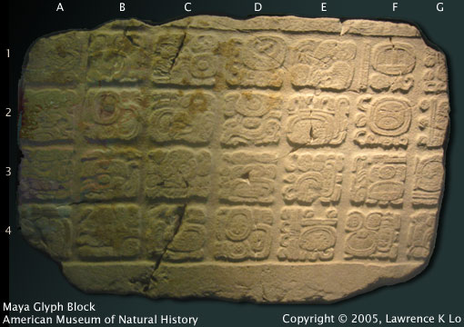
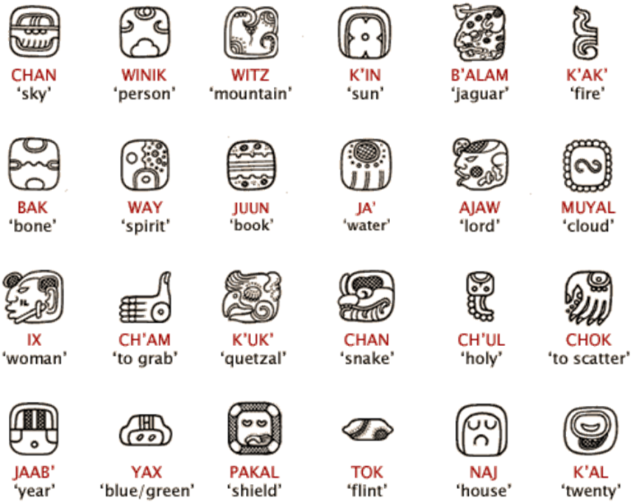
Maya glyphs are read in
"paired columns“
The first glyph block
is on the top left, the
second is immediately
to the right of the first,
the third is under the first,
the fourth under the
second, etc
MAYA WRITING IS LOGOSYLLABIC,
meaning that it uses a combination of
signs for
concepts
(words or meanings)
and signs for sounds
Notes:
Maya writing is syllabic like Chinese; there are literally hundreds of characters – each stands for a different syllable
Writing, especially on monuments was probably a lingua franca –you can translate the glyphs into any language, and because many of the major Maya languages are related, having a similar grammar it would be possible to follow the syntax no matter which language you spoke.
–decipherment is an exciting story --Yuri Knorosov - oops that’s another lecture!

Slide 11
Notes:
The Maya had sophisticated MATHEMATICS – with a concept, and a notation system for ZERO, which is a big deal if you need to make complex calculations- if you don’t believe me try to divide 6,898,136 by 42,567 – with Roman Numerals!
The complexity of their hydrology and architecture demonstrate a working knowledge of geometry

Slide 12
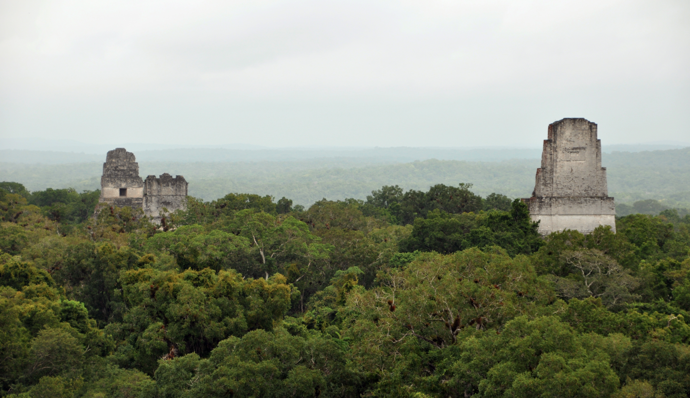
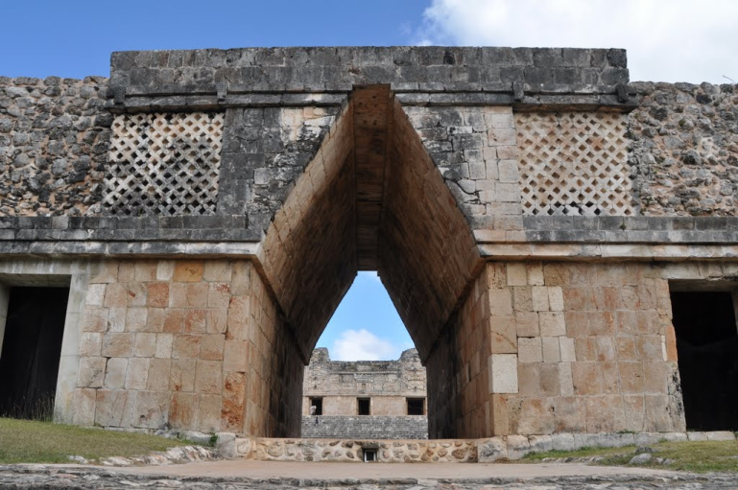
The Rebel Base, Yavin, from Star Wars Episode IV
[a.k.a. Tikal, Guatemala]
Corbelled Arch at Uxmal, Mexico
Notes:
Of course the Maya are famous for their ARCHITECTURE – until recently it we believed the Maya only used a corbeled arch not a true arch, but excavations at the site of El Ceren in El Salvador where the structures were preserved like those of Pompeii by a volcanic eruption have discovered a domed structure made of wattle and daub – another indication of geometric knowledge

Slide 13
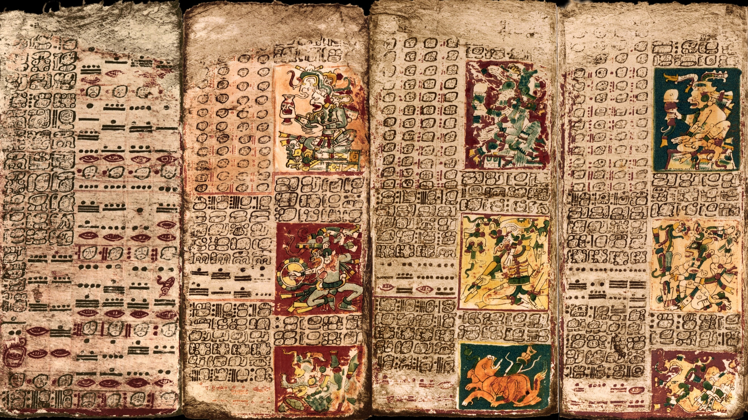
A portion of the Venus Tables from the Dresden codex
Notes:
The Maya also had advanced ASTRONOMY – they could predict eclipses very accurately; but they couldn’t predict whether they would be visible, sometimes the eclipses they predicted would be visible only in Australia – but they wouldn’t know it; most of the glyphs are really about this – oops that’s another lecture

Slide 14
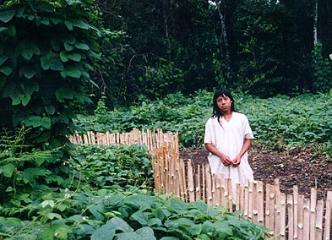
A Lacondon farmer
Chiapas, Mexico
Notes:
Maya AGRICULTURE – was complex and varied, it was specifically developed to take advantage of of microenvironmental variations in soil types, drainage patterns, climatic regimes and rainfall patterns

Slide 15
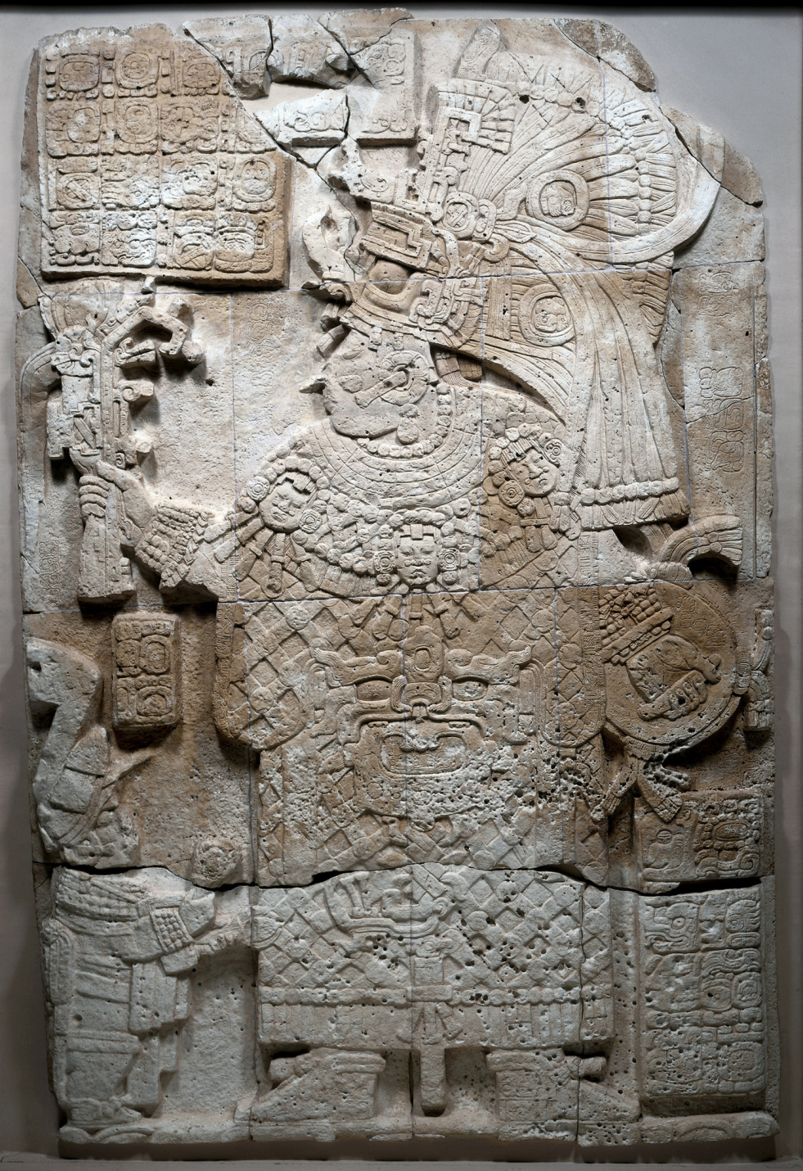
Lady K'abel
Queen of Waka,
Guatemala
Notes:
SOCIAL ORGANIZATION – If you are interested in the Maya you have probably read plenty about divine kings, but you may not know that the Maya had a system in which men and women seem to have shared social, economic and even political power much more evenly than anyone anticipated; they differed in some of their responsibilities (rope through tongue versus stingray spine through penis), but male rulers wore some female garments to prove their worthiness, just as female rulers wore some male garments to prove their worthiness. A good ruler must embody both male and female traits, so the sex of the person in the role was not so important. Some cities had more male rulers, some cities had more female rulers

Slide 16
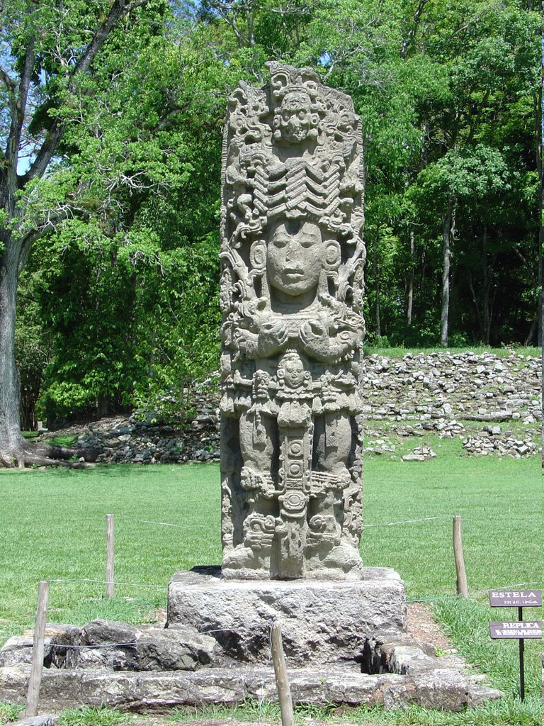
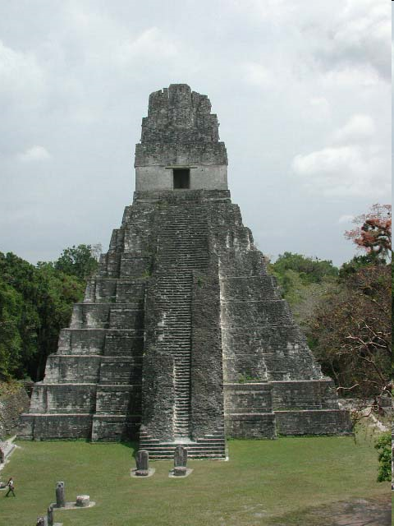
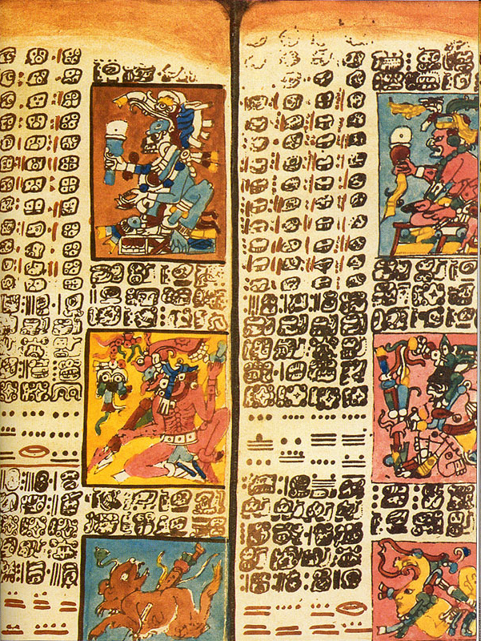
Tikal, Guatemala
Copan, Honduras
Dresden Codex
Notes:
Despite the immense amount that has been written about the Maya collapse it is still pretty hard to determine exactly what “collapsed” in the 9th century in the Maya lowlands. All our data are negatives – we define the collapse in terms of what is missing that we think should be present in the archaeological record of a not-collapsed civilization – this is appropriate – archaeology has more absent evidence than any other discipline except perhaps evolutionary psychology. Mainly the collapse is the time when stele, writing and large monuments were (mostly) no longer being used – or rather the period for which we haven’t found these things

Slide 17
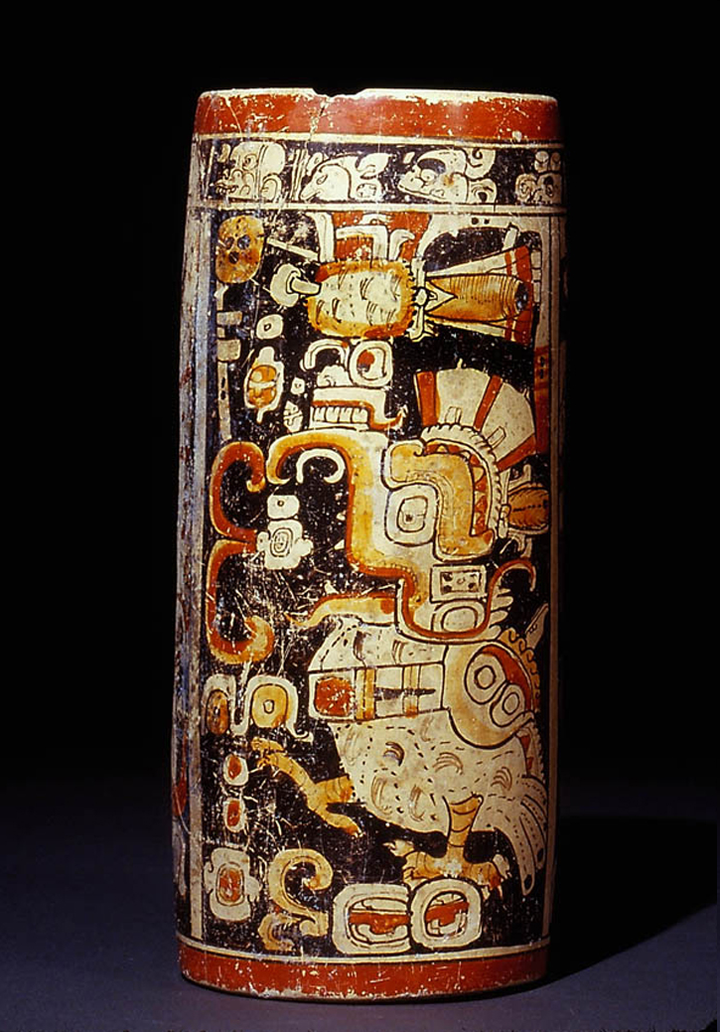
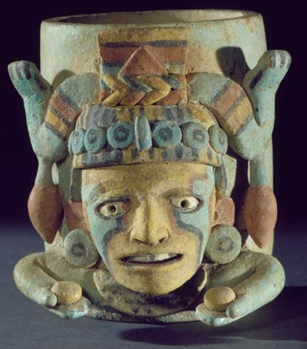
No more polychromes
These don’t count
Notes:
People also stopped making gorgeous polychrome vases like the one on the left, and they are pretty cool, but it’s hard to see the lack of them as the end of civilization. The little polychrome diving god censer on the right is clearly not as “high-arty” but it ain’t chopped liver
So there were still monumental buildings, but smaller, almost no stele, polychromes that were somewhat less fancy.

Slide 18
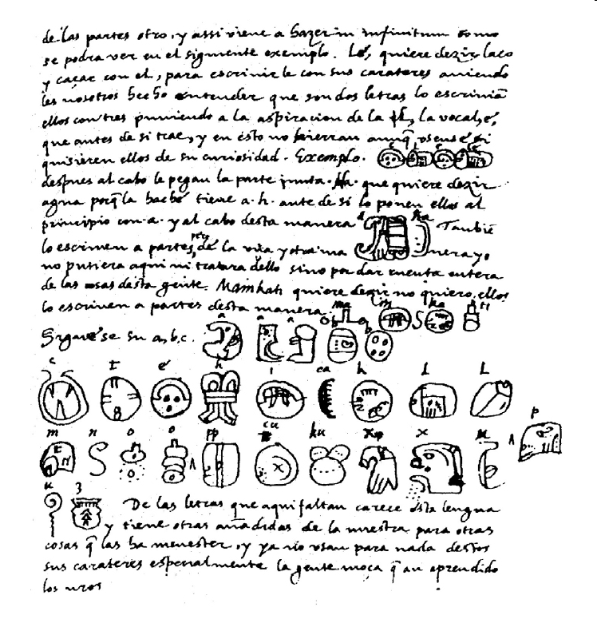
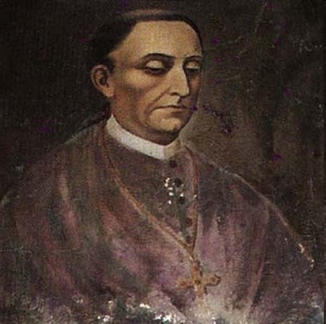
“Landa’s Alphabet”
shows that people
could still write
Maya glyphs
at the time of the
conquest
Diego de Landa
(1524-1579)
second residing
bishop of Yucatán
Notes:
So there were still monumental buildings, but smaller, almost no stele, polychromes that were somewhat less fancy. Writing didn’t really end in the Postclassic, either since we know people could still write at the time of the conquest – we have their writing that was commissioned by the Spanish. So instead of the end of written language there seems to have been a change in the way writing was used and a change in how well written documents survived for us to find – especially since De Landa burned all he could get his hands on. The older documents we have are mostly carved stele – great big rocks that are hard to get rid of, though they Maya did bury them sometimes

Slide 19
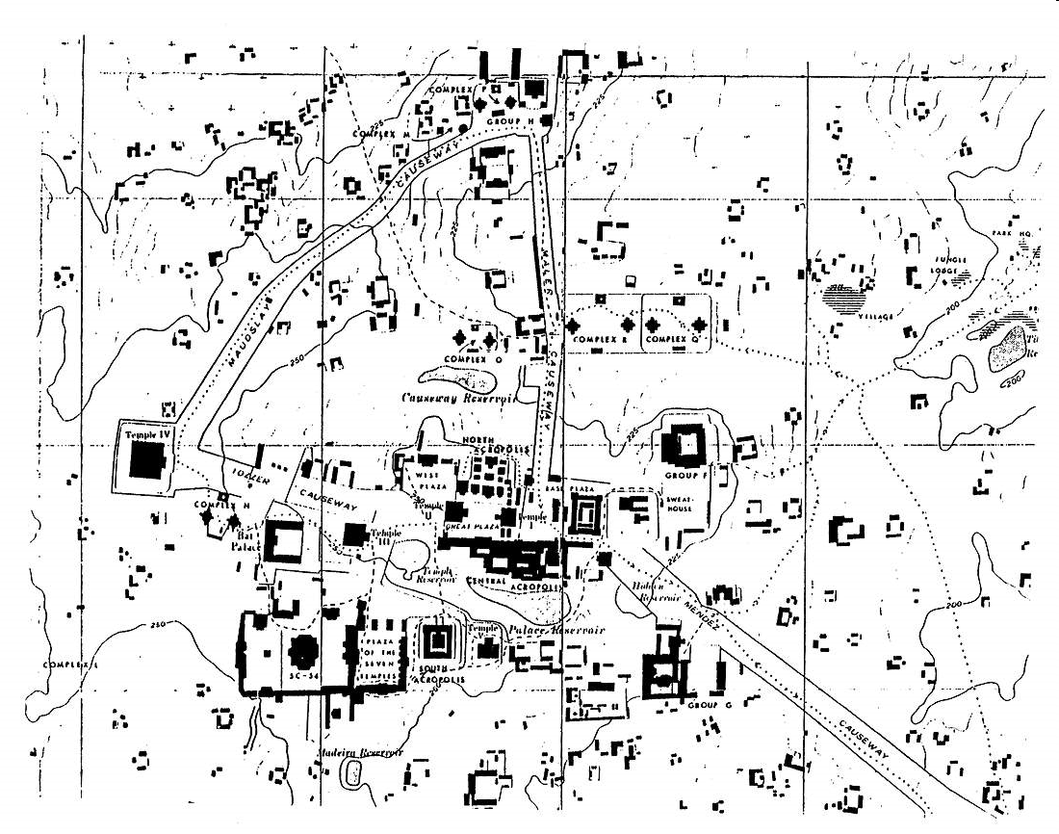
Downtown Tikal, Guatemala
Notes:
The populations of some large urban centers declined dramatically in the 9th century – except that the sudden depopulation took a hundred years or so and sometimes occurred in the 4th century or the 5th or the 7^{th …} and sometimes the people came back…

Slide 20
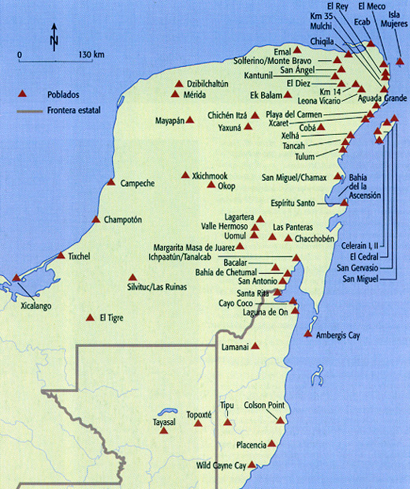
Postclassic Maya Cities
Notes:
Actually, there were plenty of Maya cities occupied and thriving at the time of the Spanish arrival, only a few of them are on this map

Slide 21
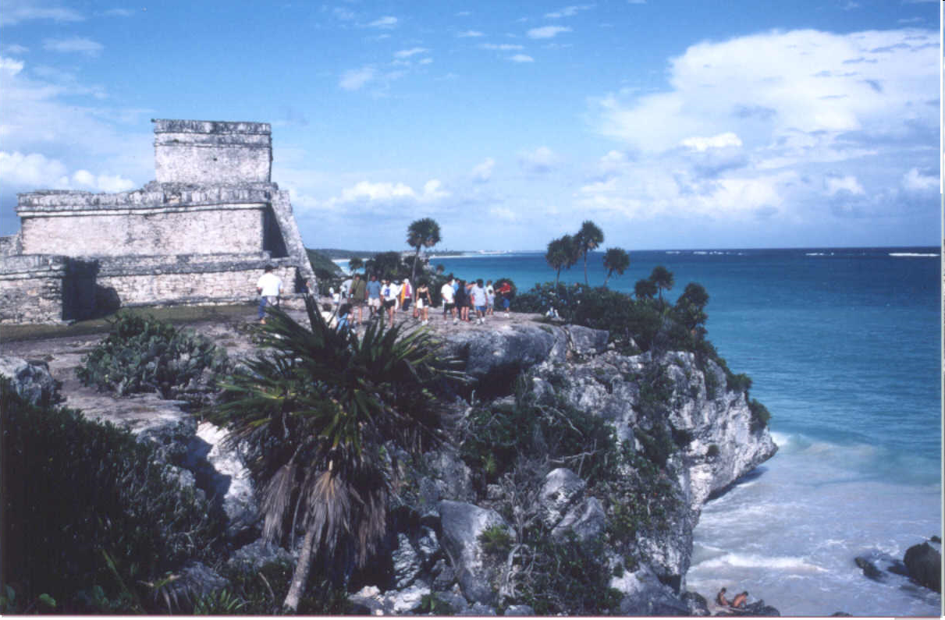
Postclassic Tulum, Mexico
Notes:
this is Tulum the first new world city seen by Cortez – it was occupied well into the 16th century - long after the “collapse”

Slide 22
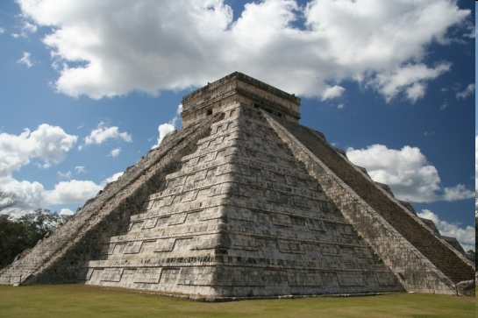
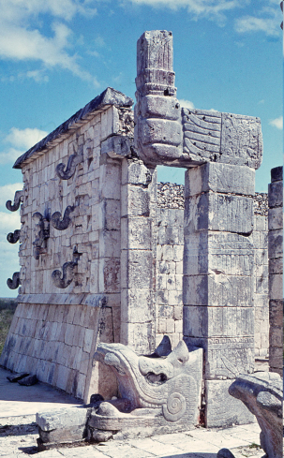
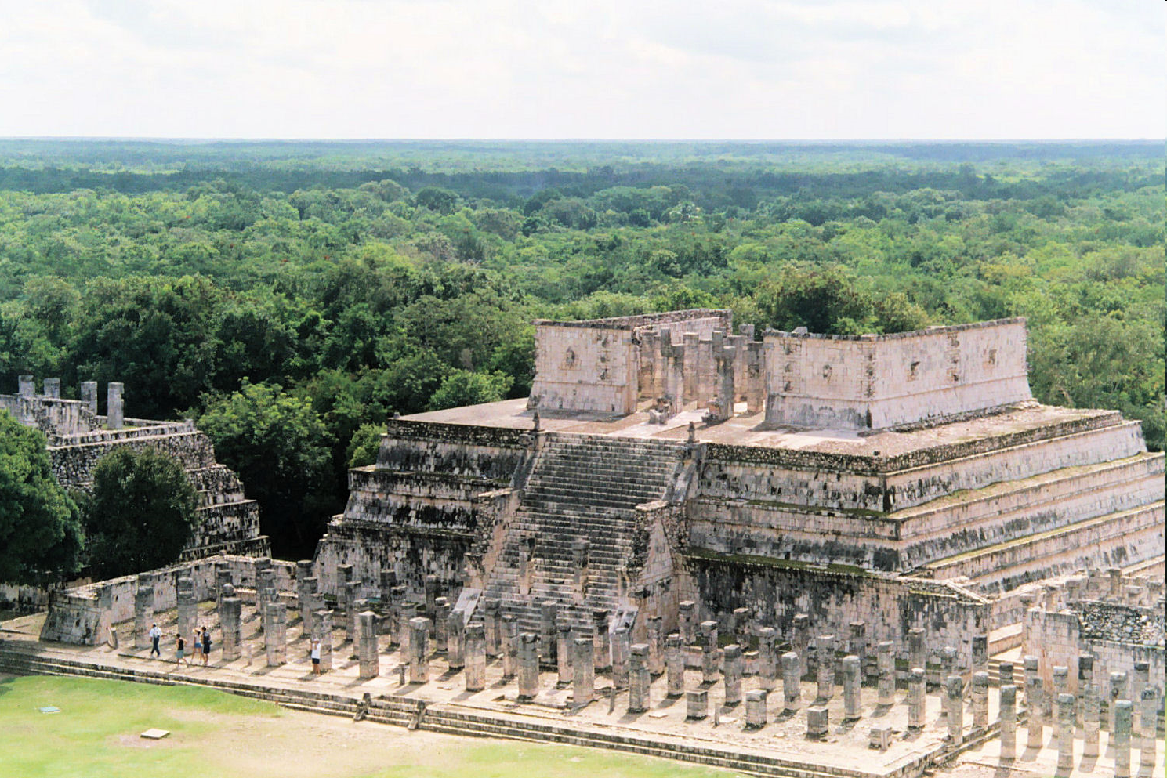
Postclassic
Chichen Itza,
Yucatan
Notes:
Chichen Itza was also occupied long after the collapse – it seems to have plenty of carved monuments and monumental architecture

Slide 23
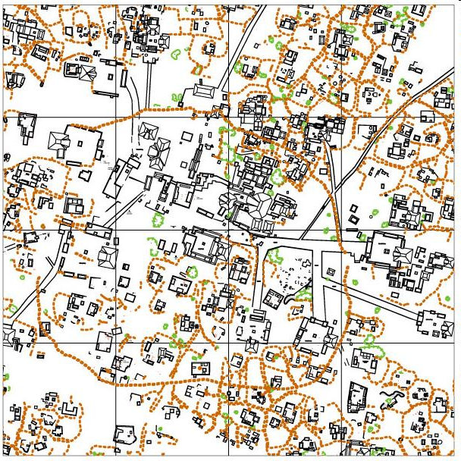
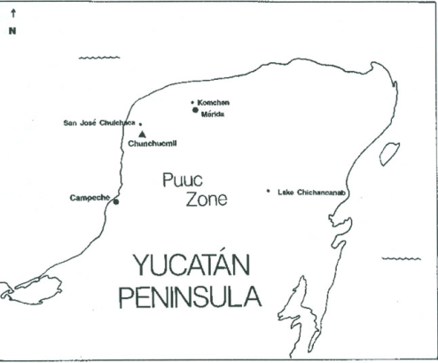
Chunchuchmil
A Postclassic
Maya City
Notes:
And the Postclassic cities like Chunchuchmil were often very densely populated– this is another Postclassic city in Mexico, less monumental architecture than Chichen a very large settlement area

Slide 24
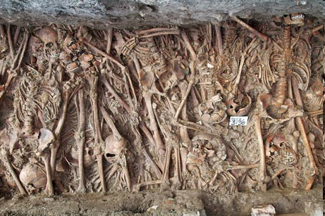
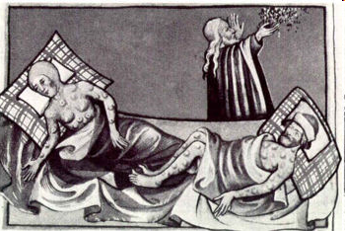
Disease
Archaeology of plague
victims in Germany
No remains of victims
No depictions in Art
Usually the Elite survive
and people come back
Notes:
Now that we have reviewed the somewhat sketchy data on the Maya collapse, let us turn to the explanations. Our extensive missing evidence does not support any of the obvious possibilities We don’t see evidence of DISEASE – though some sites seem to show malnutrition. But a bad diet is not the same as starvation; some people apparently made themselves sick by eating too much corn – this was not because they didn’t have anything else, but because they didn’t want anything else.
When the plagues swept through Europe, some people always survived, and often their skeletal remains show some evidence of trauma. Also, When people die of plague – what part of the population goes first? Not the elites! but that’s clearly what happened, since it was palaces were abandoned as well as the ordinary houses.
In fact we know more about how many palaces were abandoned because they are relatively easy to find archaeologically, even after 1000 years the stones linger. But little dirt floored houses could be occupied for hundreds of years and leave almost no archaeological trace.

Slide 25
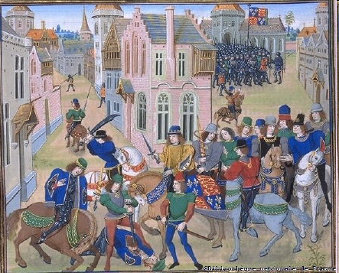
Peasant Revolt
Peasants
revolt against bad lords,
but they want a better lord,
not a new system…
and they don’t
disappear.
Notes:
We don’t have any direct evidence of peasant revolt in art or burials or written records – and peasants do not revolt and then disappear, nor historically do they create a new social order – they just want a better king, not no king! Maybe the elites were too greedy. It does look like the growth of the size of the elite population may have been enough to tax the lower classes who were feeding them and the rate at which palaces were being built suggests that the laborers may have been overworked. Perhaps the society was getting top heavy with too many elites and not enough producers. But we don’t have evidence of the burning of palaces, and we see the disappearance of the commoners, too.

Slide 26
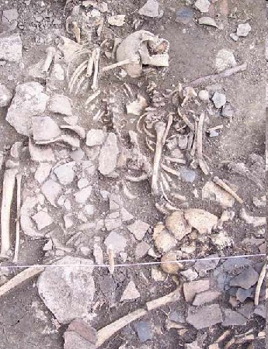
Warfare
Where are the bodies?
The winners usually do
not want the producers
to leave
If they do,
then they move in.
Battleground
Preservation
Kuélap
Chachapoya
Peru
Notes:
The evidence for warfare is also surprisingly thin, we know that Maya warriors did fight, we now have evidence from the Petexbatun region of Guatemala that warfare and serious raiding were endemic and that in fact some of the cities in this region were de[populated as early as the 6th century – 200 years before the collapse occurred elsewhere. And warfare on a small scale is hard to find archaeologically – we don’t have any mass burials, we don’t have any systematic destruction of buildings. Nevertheless, we are talking about a huge number of people; when you think about killing 100,000 people by hand at a single city – with clubs and wooden swords with obsidian inlaid edges, it’s hard to believe it would be possible and that if it was done it wouldn’t leave evidence. More to the point, what do invaders want when they conquer a new territory? They usually want to squeeze it for tribute in goods and food, and they may want to move some of their people in. We don’t see this – we just see depopulation. Empty land is no good to a conqueror.

Slide 27

Mural from Bonampak
Notes:
Most of the evidence for Maya violence and warfare comes from iconography, but scary images are hard to evaluate. Did this sort of thing happen all the time or was it being commemorated because it was a rare and unusual event? Is it accurate or was it exaggerated to frighten the neighboring community when they came to visit? Is it perhaps allegorical? You wouldn’t count the crucifixes in Bloomington Indiana to find out how frequently we practice crucifixion…
Both the ancient Maya and modern archaeologists have exaggerated their claims about violence

Slide 28


Overpopulation
Even ideologically
Motivated groups
regulate their
populations
?
Notes:
Overpopulation to the point of starvation decimates populations pretty quickly, but then the survivors don’t leave…
And with war, malnutrition, disease – the elites tend to survive, but what we seem to be missing archaeologically are many of the trappings of elite culture
Big palaces and temples, billboards advertising the power of kings and queens, very fancy pottery made by full time specialists
it does look like population may have gotten large enough to strain the food supply, though we still don’t have much data on malnutrition – most recently some claims have been made for food shortages at Copan. But this is where it is important to remember that the Maya had succeeded for 2000 years to match their population to their production. In places where overpopulation is documented, the result is not that everybody abandons their land. People suffer and struggle and figure out ways to accommodate themselves to shortages

Slide 29

From a tourist’s website…
“Unfortunately, some of the more destructive practices of the Maya, such as slash and burn agriculture, are still being practiced today. ”
Stutzfamily.com Travel Pictures
Notes:
Then there is the environmental degradation story- it’s the fault of the farmers

Slide 30

Myths about slash and burn agriculture
Slash and burn is unsustainable
Slash and burn caused the Maya collapse
Slash and burn cannot produce a surplus
All Maya use slash and burn
Slash and burn is the same everywhere
All jungle is the same
Notes:
Here are the common beliefs about Maya agriculture that most people have heard

Slide 31


Slash and burn is
sustainable, takes
very little land for a family,
varies according to
Microenvironment,
is only one type of Maya
agriculture.
Notes:
But slash and burn is sustainable and can produce a surplus but you have to know your environment very intimately; Many Maya towns and villages were occupied for well over 2000 years – plenty of time to get to know your environment.

Slide 32




There are
many types
of environment in
the Maya area
…and there
are many types
of Jungle
Notes:
There are many environments in the Maya area and many types of agriculture – the Spanish mostly saw people practicing slash and burn – if you are driven from your home and escaping into the jungle into unknown microenvironments and have no time to develop proper fields – you slash and burn; if your workforce is devastated by disease and conquest, slash and burn in primary forest is expedient. [80% of Maya people died as a result of the conquest]
Many of the ancient strategies have died out and are only known from archaeological reconstructions

Slide 33

Terraces
are one of
many types
of land
modification
the Maya
used
Notes:
Now that we know what to look for, we find agricultural terraces everywhere

Slide 34

Canals;Ridged,
Raised,
&
Island Fields
Notes:
But we also have evidence of massive hydrological control features. Here is a set of canals and dams I discovered 20 years ago that I was afraid to publish because they were so unbelievably massive. I did publish them, and recently junior colleague has restudied them and expanded them to 3 times the size I claimed for them

Slide 35



Farming the swamp is a
very sustainable
strategy
Ancient Maya raised fields
Notes:
By far the most exciting discovery about the Maya has been raised fields, they are amazing. They provide transport, fertilizer, and pest control plus aquaculture
ELABORATE

Slide 36




aquaculture
Diversification
is a good
strategy
for sustainability
Notes:
AQUACULTURE - Maya farmers used the canals between the fields to farm fish and snails

Slide 37

Average rainfall in Belize varies from 60 inches in the north to 180 inches in the south
Drought?
Notes:
No doubt you have heard that Maya civilization collapsed because of Drought - The places that were abandoned do not conform to the places where drought would have hit the hardest; several sites in southern Belize were abandoned, such as nimli punit – it had an average yearly rainfall of over 180 inches. Sites in the Yucatan grew after the 9th century, suggesting that population moved northward

Slide 38




Yucatan’s dry coastal areas and scrub forest
Where you go to escape drought?
Notes:
Where you go to escape drought? So drought caused people to move from the wettest places to the driest?

Slide 39

environmental
degradation
war
Notes:
Frankly, I am not really very interested in the absolute truth of claims that Maya cultures were affected by warfare, drought and overpopulation in some areas at some times – these all occur in the history of any long-lived culture. The focus of academics on one or the other of these causes has as much to do with modern political preoccupations as to the scientific recovery of new data. Certainly problems that are plaguing us now plagued people in the past. I went through all these explanations to show that none of them has a solid foundation in archaeological science and all of them are built on a small amount of data that has been highly selected and vastly over interpreted. There are many other ways to interpret these same data
This graph is from a study done by Rick Wilk who counted the number of publications attributing the Maya collapse to a particular cause over time. He found that the number of papers attributing the Maya collapse to environmental degradation peaked around the first earth day, those attributing it to war rose sharply around the time of the first Vietnam moratorium, and the publication of Paul Erich's book The Population Bomb coincided with a rush of papers attributing the collapse to overpopulation.
He did the study in the 1980s; I leave it to you to decide whether the current cultural context might encourage people to suggest the Maya collapse was caused by drought.

Slide 40

Notes:
Population movements from one type of city to another that was more densely packed and had fewer gigantic elite structures, the reduction of time and effort spent on elite material culture (dishes and palaces and stele bragging about the divinity of a king) suggest an important change, but not necessarily a bad one. Whatever you think happened in the 9th century, the result seems to have been that the gap between the rich and the poor, between the kings and their subjects got smaller, and it could be argued - and has been – that the standard of living for ordinary people improved.
I believe that the places that were completely abandoned were often managed estates, where residents were landless peasants and sometimes slaves who labored for an absentee landlord who funnelled the wealth they produced to support an elite lifestyle in one of the larger urban centers. When this link was disrupted, lifestyles of the rich plummeted and the archaeological record of their excesses collapses. And then the people who supported them were free to move onto land of their own, to grow crops for themselves to meet their own needs and devise new sorts of political economy. At the time of the conquest, several towns were reported to be run by small committees who acted together to make decisions for their people. Many Maya communities are run this way today.

Slide 41

Notes:
But this is a story about the triumphs and achievements of ordinary people, managing to cope with political pressures and environmental challenges. In fact it is a story about sustainability and the evolution of cultural strategies that became more democratic and less archaeologically visible but not less organizationally successful or even less complex. National Geographic doesn’t think the absence of violence and divine kings is sexy enough to sell magazines and they may be right. But the problem with lurid stories about the Maya collapse is not just that they are inaccurate; when people see only horror in a particular heritage, there are very real negative consequences in the present.
People in the past made mistakes just as people in the present, and deserve credit and blame just as do modern people for greed and excess and miscalculation. But to look at the past with a jaundiced eye as only a source of cautionary tales about a past we don’t want to be condemned to repeat is a focus on our fears and concerns about our own era; instead of reading our errors onto the past, I think there are better lessons to learn

Slide 42


anthropogenic soils
A layer of rich, black terra preta lies
atop a layer of light brown,
nutrient-poor rainforest soil
near Manaus, Brazil.
reintroduction of raised field agriculture
Some pasts deserve repeating
Notes:
If you think about it, Maya speaking people have been farming the rainforest successfully without machinery, pesticides or chemical fertilizers for 3000 years Their adaptive systems have withstood disease and drought and war and invasion. This is a level of sustainability few cultures can match and rather than a cautionary tale, it may provide us with important clues to the best way forward.

Slide 43



Bob Netting with
Kofyar farmers
Smallholders
Nigeria
Switzerland
Notes:
One thing that agronomists and development workers have been saying for years, but not getting across is that by far the most efficient type of agriculture is small family farms. The amount of production per unit of land from small family farms far outstrips mechanized agriculture and agribusiness for both productivity and sustainability. Smallholders, people who own their land and pass it down from generation to generation, exist all over the world, from Nigeria to Switzerland and their farms are incredibly productive and sustainable. We can add to this argument 3000 years of Maya agricultural practices.
Of course it is possible to practice unsustainable slash and burn agriculture and certainly this is happening in some parts of Mesoamerica and south america. But it happens when people do not have enough land to develop a sustainable system and no land rights that would make investment in sustainable technologies like terraces and raised fields feasible.
Land shortages in Latin America are largely due to the huge areas of land sold to giant multinational corporations for raising cattle, leaving poor families without enough land to sustain themselves. In desperation they sometimes sneak onto land and farm it rapidly just for food. Blaming them for land degradation is blaming the victims

Slide 44


After decades of lawsuits in the national courts in Belize, the Caribbean Court of Justice, Belize’s highest appellate court, reaffirmed that the 38 Q’eqchi and Mopan Maya Indigenous communities of southern Belize have rights to the lands they have customarily used and occupied.
Notes:
Cutting living Maya people off from pride in the accomplishments of their ancestors undermines them politically. The government of Belize challenged the land rights of a group of Q’eqchi Maya living in southern Belize.
The governnment want the land because oil has been discovered on it; they want to see the oil rights and the timber rights.
Some (but not all) of the ancestors of these Q’eqchi were enslaved by a German Chocolate plantation owner and forced to move to Guatemala; many families came back to Belize and resettled Toledo where they have lived for the past 300 years. The government of Belize argued that they have no land rights because they are not indigenous to Belize; almost all archaeologists who work in Belize are supported the government, not the Maya. No one wants the Maya to have control of their heritage - either lands or cultural property
The Maya won their case in international court and Belize appealed the decision. But just 2 years ago in 2015, the government of Belize gave up and admitted that the Maya have land rights. Belize is still trying to cheat the Kekchi out of these rights, but this is an international precedent. Perhaps one day Maya people will have some say in how their history is told and how their heritage is used.

Slide 45

The Guatemalan Civil War,
the longest civil war in
Latin American history,
ran from 1960 to 1996.
Notes:
A few years ago I met a Quiche Maya woman – she was a refugee from Guatemala living in Canada – who told me that when she walks down the street in her traje (traditional clothes) people stop her and ask her where she is from. When she says she is Maya they invariably say (with varying degrees of politeness) Oh, I thought you were all dead!
So then she patiently explains that there are over 8 million people alive today who speak a Maya language, and that she is a refugee from the Guatemalan Civil war. To which the nice Canadian person usually blurts out “What civil war?”
Since her whole family was murdered in this war she cries when she tell this story

Slide 46

Over 200,000 people were killed
85% were Maya
The Guatemalan Civil War, the longest civil war in
Latin American history, ran from 1960 to 1996.
Notes:
This ignorance is common on this side of the border as well; last year my undergraduate class on Maya archaeology was astounded by the civil war – they had never heard of it and were very upset about it. They couldn’t understand why none of their teachers had ever mentioned it. But this is not just a result of a lack of attention to world politics, it’s a result of the way scholars and the media have promoted the idea of a Maya collapse – not just as a tragedy but as a great failure brought on by the Maya themselves, which makes the fate of the few remaining stragglers seem insignificant. And I can tell you that as more and more Maya people get the opportunity to be educated and learn about the way they are portrayed and the way their heritage has been sold out to National Geographic and Hollywood, the less friendly they are to archaeologists and to this sort of claim
It is said that during the height of the genocide of Maya people in Guatemalan that generals in the Guatemalan army quoted archaeologists about the brutality of the ancient Maya as part of their rationale for extermination; it is certain that professional archaeologists were paid to consult on Apocalypto – they are in the credits

Slide 47

Notes:
The fascination with the “collapse” of other civilizations is very much a part of western heritage, a heritage of political and economic domination on a global scale. By using the past to warn against the errors of the political present, we may be doing a service to the people of our own heritage by promoting awareness and change. But at the same time the stereotyping of the heritage of other people promotes acceptance of the status quo, in which the survivors of collapse are tended by those whose civilizations have succeeded.

Slide 48

"Lady Xok and the Vision Serpent," Lintel 25 from Yaxchilan.
Stone carving (replica), Maya (circa AD 725), Chiapas State, Mexico
Notes:
Many other stories about the past are told to justify the status quo. Gender equality, objective reasoning, intercultural diplomacy... these are all areas where we might learn something useful from the past if we ask better questions. It seems to me that archaeologists and their public are in need of some different lessons from the past, and a spate of research on the “success of ancient civilizations.”

